Slide 1
Speech to Art using AI
Capstone Project
By:
Omnia Elmenshawy – 2000007
Qatrlnada Almrzoq – 1900678
Hashem Alshami - 1900257

Slide 2
AGENDA
Overview​
Libraries Used
Speech Recognition
Speech to Text Function
Hugging Face API
Text to Image function
User Interface Function
Results
​​

Slide 3
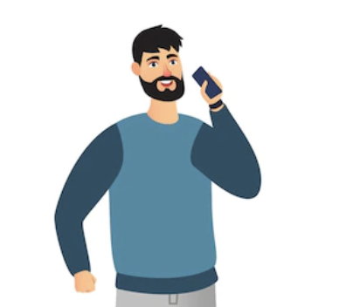
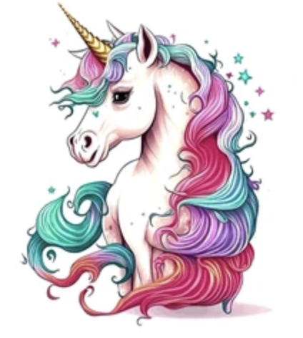
Overview
Speech to Text
&
Text to Image
Speech
Models
Art

Slide 4
Libraries Used
SpeechRecognition ​​
Tkinter
Requests
PIL

Slide 5
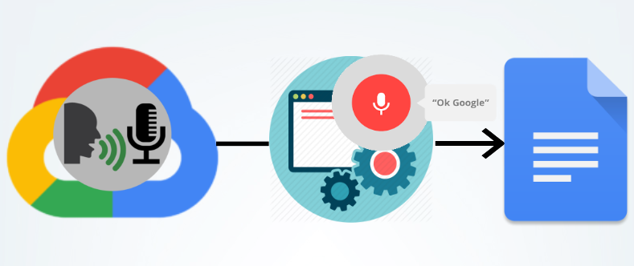
Speech Recognition
Google Speech Recognition API
The Speech Recognition library send Audio to Google’s speech recognition API then returns the transcribed text

Slide 6
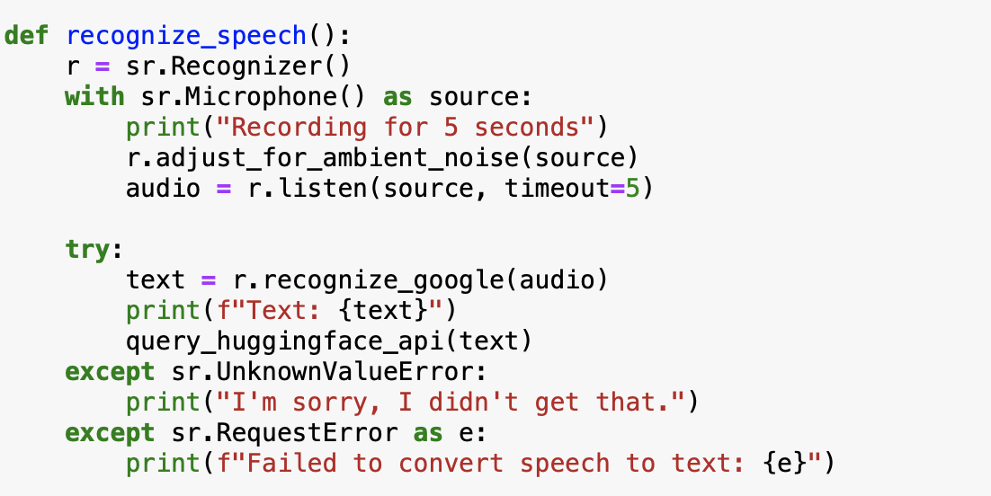
How our ‘recognıze_speech’ functıon Work?

Slide 7

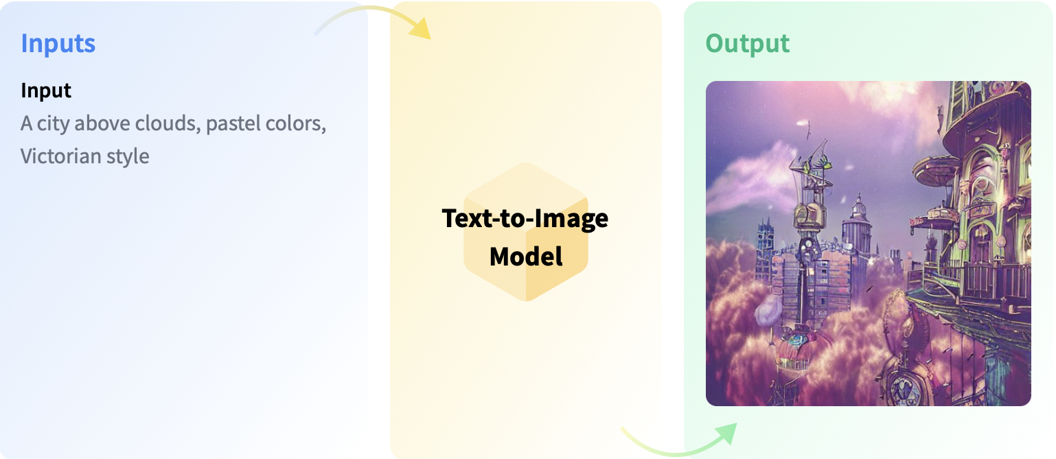
Hugging Face API
Stable Diffusion 2-1

Slide 8
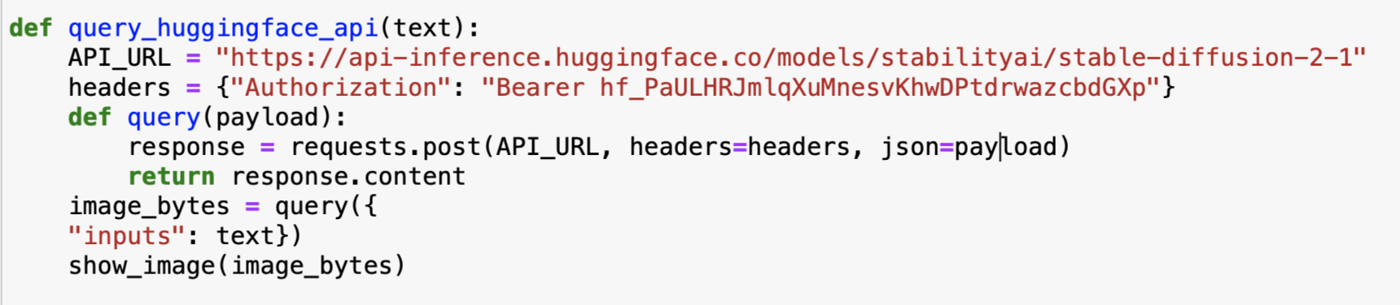
How our ‘query_huggingface_api’ functıon Work?

Slide 9
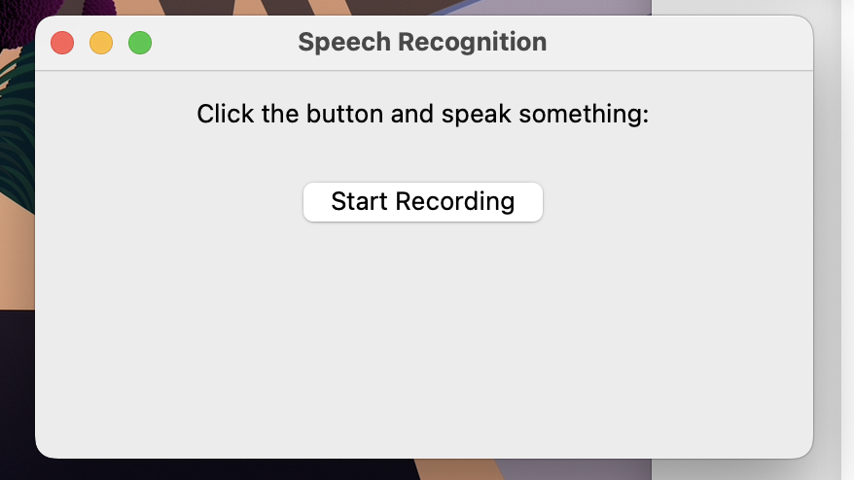
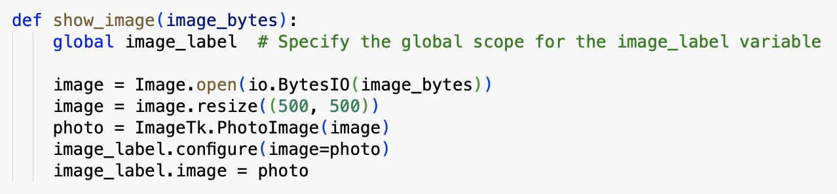
User Interface Function
Tkinter GUI – ‘Show_Image’

Slide 10
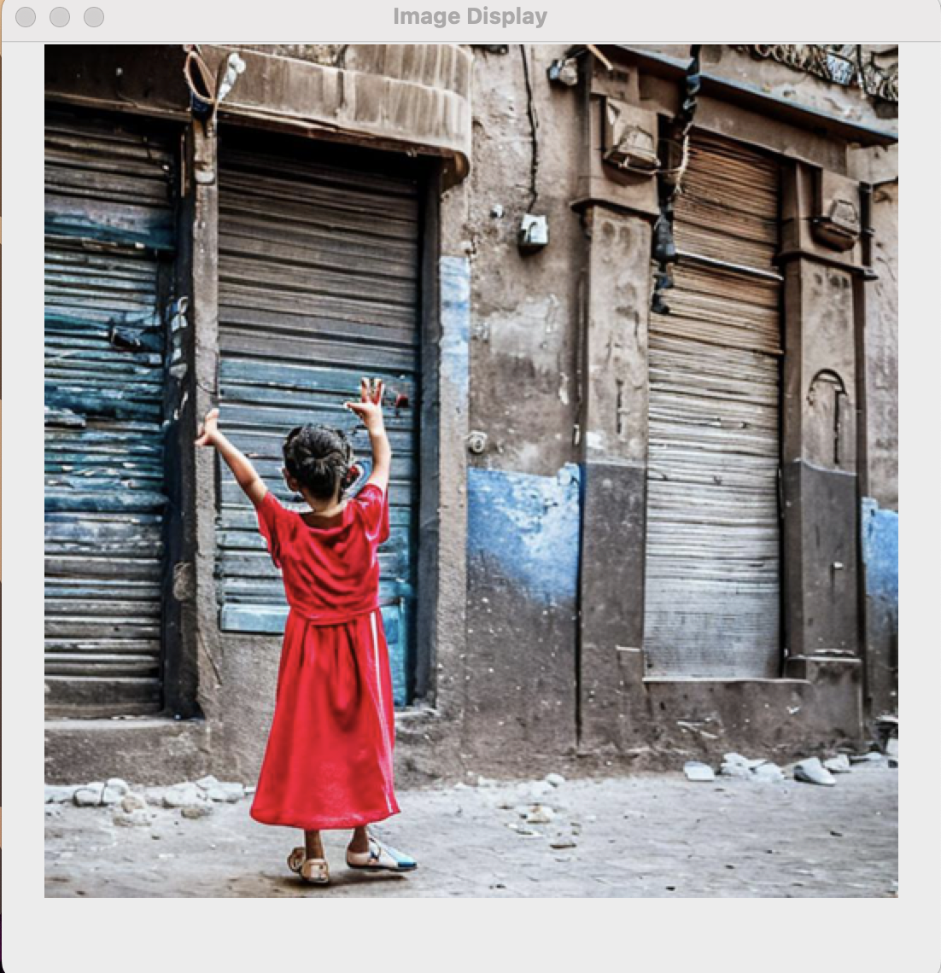
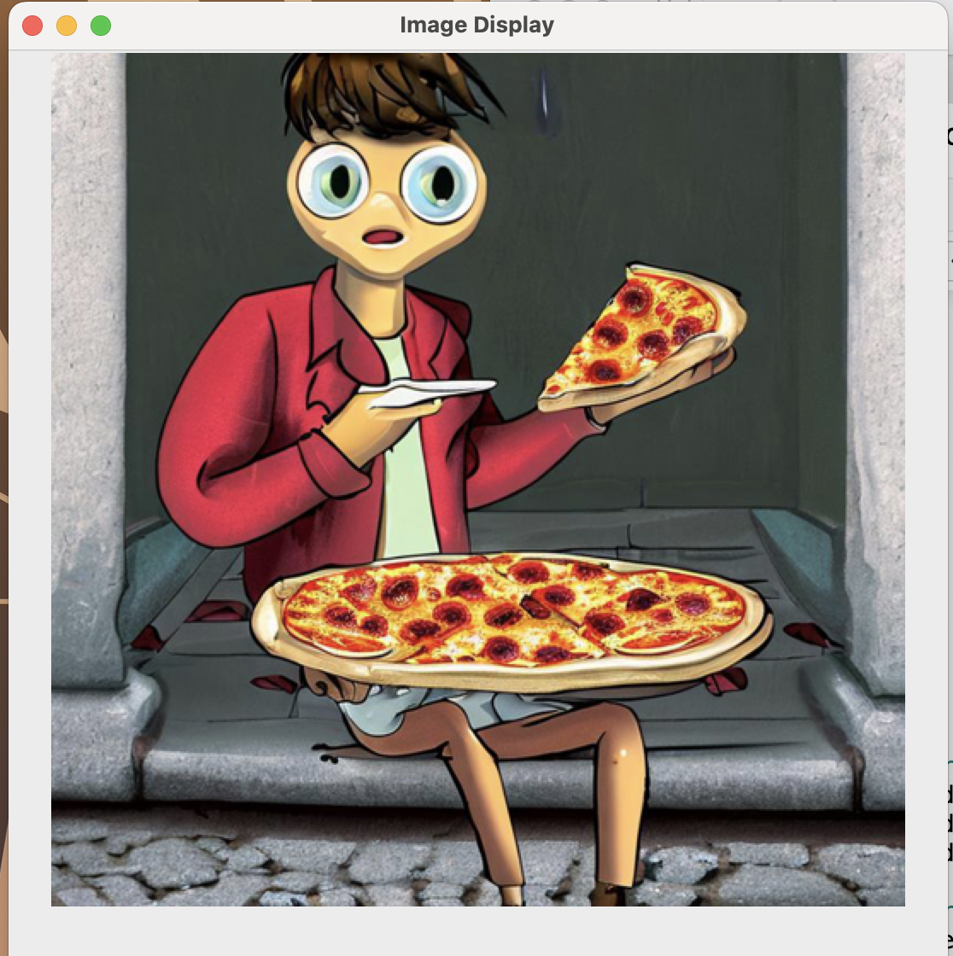
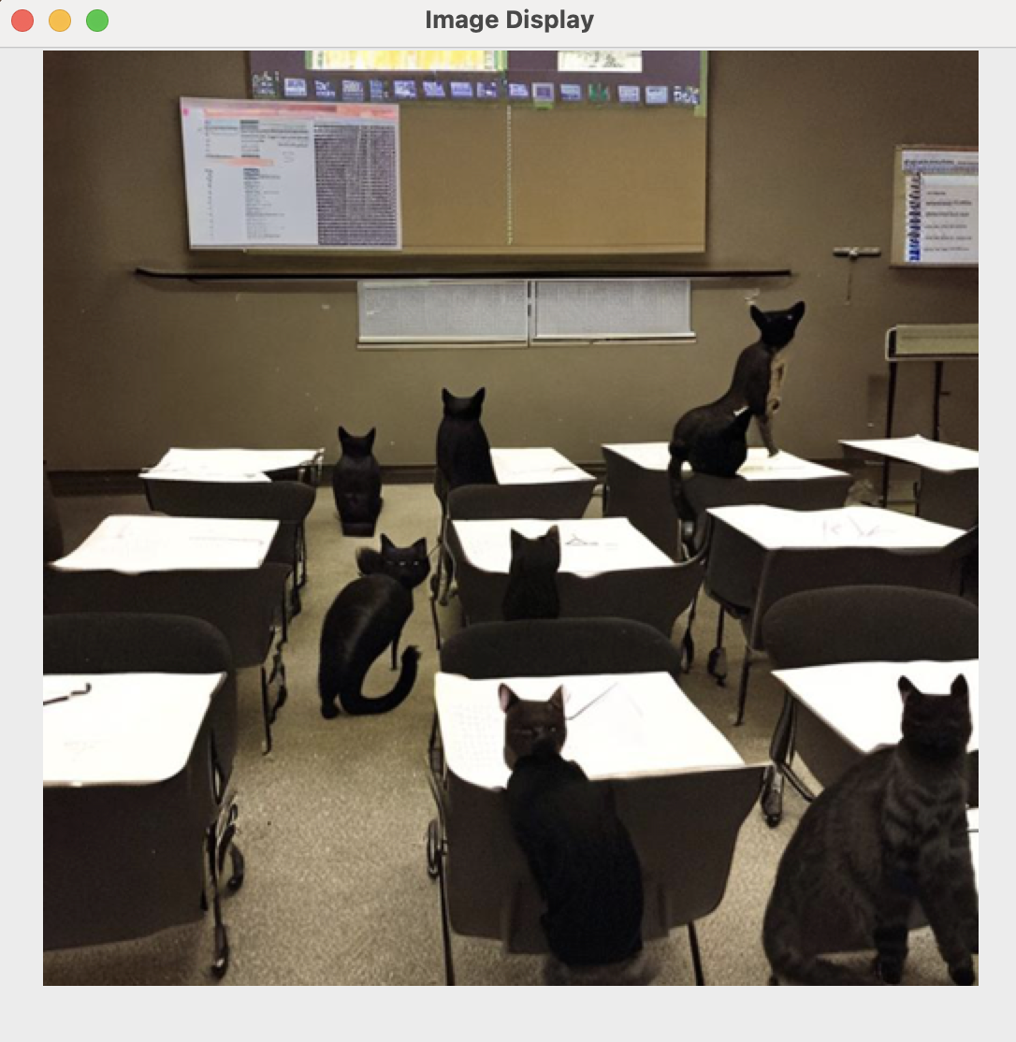
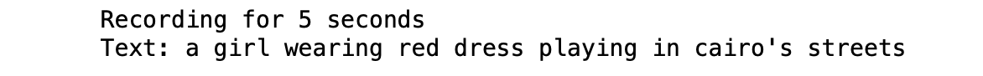


Results

Slide 11
THANK YOU

